Slide 1

Traffic management with Arduino using Iot

Slide 2



List of contents
Problem
Flowchart
Solution
Dependencies

Slide 3




Introduction
In an era of rapid urbanization and technological advancement, managing urban traffic has become a critical challenge for city planners and policymakers worldwide. The traditional methods of traffic control are proving to be insufficient in handling the escalating complexities of modern urban environments. In this context, the integration of Internet of Things (IoT) technologies presents a groundbreaking solution..

Slide 4

Problem

Slide 5
Problems with traffic control: Congestion: Traffic congestion is a widespread issue in many cities, leading to delays, increased travel times, and frustration among commuters. It can occur due to a high volume of vehicles on the road, inadequate road capacity, and inefficient traffic management. Inadequate Infrastructure: Outdated or insufficient road infrastructure can lead to traffic problems. Narrow roads, poorly designed intersections, and lack of proper signage can contribute to traffic bottlenecks and accidents. Distracted Driving: The proliferation of mobile devices and other distractions can lead to distracted driving, which is a significant cause of accidents and traffic problems. Drivers who use their phones while driving are less attentive to the road and are more likely to cause accidents.

Slide 6
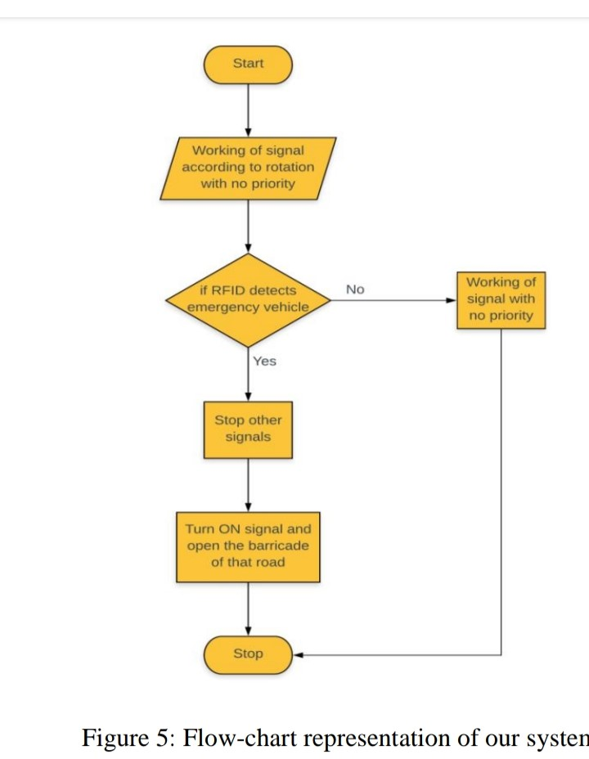
flowchart

Slide 7

Solution

Slide 8
Dependancies
Traffic Lights (LEDs): Traffic lights are a fundamental component of traffic management. They control the flow of vehicles and pedestrians at intersections. Arduino microcontrollers are used to program and control the timing of the traffic lights.
Sensors (IR, Ultrasonic, etc.): Sensors are crucial for detecting the presence of vehicles, pedestrians, or other objects. They provide input to the Arduino, which can then make decisions based on this data. For example, an IR sensor might be used to detect vehicles waiting at a red light.
LCD Displays: LCD displays provide information to drivers and pedestrians about the status of traffic lights or important messages. The Arduino controls what is displayed on the screen based on the traffic conditions.
Traffic Flow Algorithms: These are algorithms implemented in Arduino code that determine how traffic lights should change based on sensor inputs. For instance, if a sensor detects a vehicle waiting at a red light, the algorithm might shorten the red light duration.

Slide 9
Effects
advantages
disadvantages
Cost-Effectiveness: Arduino-based solutions are generally more affordable compared to complex, proprietary traffic management systems. The components are widely available and relatively inexpensive, making them accessible for municipalities with limited budgets.
Flexibility and Customization: Arduino allows for highly customizable solutions. It can be programmed to adapt to specific traffic conditions, intersection configurations, and local requirements. This flexibility enables tailored solutions for different urban environments.
Ease of Programming: Arduino's user-friendly programming environment simplifies the development process. Even individuals with basic programming knowledge can create effective traffic management systems. This accessibility promotes innovation and experimentation in traffic control.
Limited Processing Power: Compared to more advanced microcontrollers or dedicated traffic management systems, Arduino boards may have limited processing power. This can constrain the complexity and sophistication of algorithms, potentially leading to suboptimal traffic control in highly complex or congested areas.
Limited Input/Output Ports: Some Arduino models have a finite number of input/output ports. This may restrict the number and variety of sensors, displays, or other components that can be integrated into the system.
Dependence on Sensors: The accuracy and reliability of an Arduino-based traffic management system heavily rely on the performance of sensors. If sensors malfunction, provide inaccurate data, or fail to detect objects reliably, it can lead to incorrect traffic control decisions.
.

Slide 10

Team members
1.AKASH 2.PRASANNA 3.VIGNESH 4.RAMKUMAR 5.YOGESHWARAN 3RD YEAR CSE, NADAR SARASWATHI COLLEGE OF ENGINEERING AND TECHNOLOGY

Slide 11


Thank You

